Slide 1
__L1n__w@tch
Ten Quiz

Slide 2
Question 1
An attacker intercepts the following ciphertext (hex encoded):
20814804c1767293b99f1d9cab3bc3e7 ac1e37bfb15599e5f40eef805488281d
He knows that the plaintext is the ASCII encoding of the message "Pay Bob 100$" (excluding the quotes). He also knows that the cipher used is CBC encryption with a random IV using AES as the underlying block cipher. Show that the attacker can change the ciphertext so that it will decrypt to "Pay Bob 500$". What is the resulting ciphertext (hex encoded)? This shows that CBC provides no integrity.
解析：
前16个字节是IV，后16个字节是密文。只要找到密文’1’对应的位置，在IV相应位置进行异或即可。

Slide 3
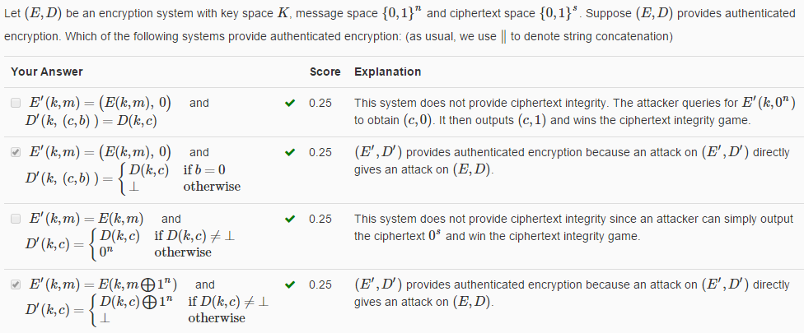
Question 2
解析：
判断是否具有CPA安全和密文完整性即可。

Slide 4
Question 3
If you need to build an application that needs to encrypt multiple messages using a single key, what encryption method should you use? (for now, we ignore the question of key generation and management)
Your Answer |  | Score | Explanation
use a standard implementation of one of the authenticated encryption modes GCM, CCM, EAX or OCB. | Correct | 1.00
use a standard implementation of CBC encryption with a random IV.
invent your own mode of operation and implement it yourself.
implement OCB by yourself
解析：
视频7-4里面指出不要自己先加密后MAC（实现认证加密系统），就使用标准中的一个。

Slide 5
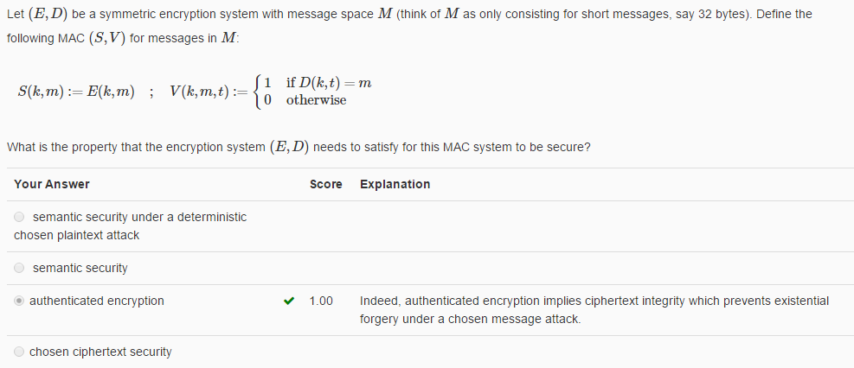
__L1n__w@tch
Question 4
解析：
MAC安全的要求是攻击者不能够做一种“存在伪造”，chosen message attack。只有认证加密能够保证（密文完整性提供了这种保证）

Slide 6
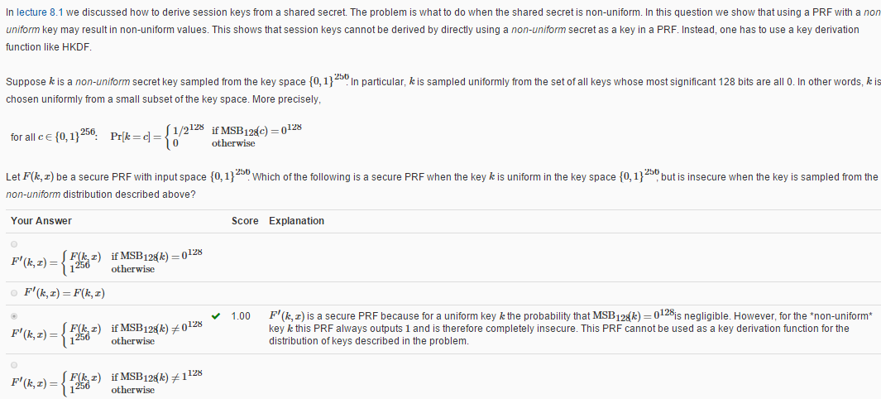
思路
__L1n__w@tch
Question 5
题目问哪个PRF是：随机密钥时安全，不是随机密钥时不安全
均匀分布的k，99.9999%以上输出F(k,x),而F是一个安全的PRF
不均分分布的k，100%输出1
解析：
这道题的不均分分布的k是前128位全是0，要求此时不是一个安全的PRF。而对于均匀的k要求此时为安全的PRF。

Slide 7
Question 6
In what settings is it acceptable to use deterministic authenticated encryption (DAE) like SIV?
Your Answer | Explanation
when the encryption key is used to encrypt only one message. | Deterministic encryption is safe to use when the message/key pair is never used more than once.
when a fixed message is repeatedly encrypted using a single key.
to individually encrypt many packets in a voice conversation with a single key.
to encrypt many records in a database with a single key when the same record may repeat multiple times.
解析：
确定性CPA安全要求密钥，信息对不重复出现。第一个选项中密钥信息对只出现一次，满足要求。

Slide 8
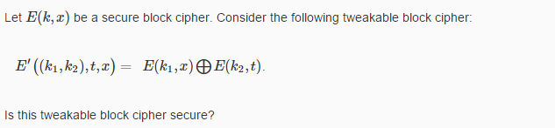
__L1n__w@tch
Question 7
解析：
a. [0](m1) -> E(k1,m1) xor E(k2,0)
b. [1](m1) -> E(k1,m1) xor E(k2,1)
c. [0](m2) -> E(k1,m2) xor E(k2,0)
d. [1](m2) -> E(k1,m2) xor E(k2,1)
He then computes
a ^ b = E(k2,0) ^ E(k2,1)
c ^ d = E(k2,0) ^ E(k2,1)
The attacker checks that a^b==c^d. With very high probability, he will
determine whether or not the challenger is using E'. Therefore his advantage
in the tweakable CPA game is ~1 and E' is not secure.

Slide 9
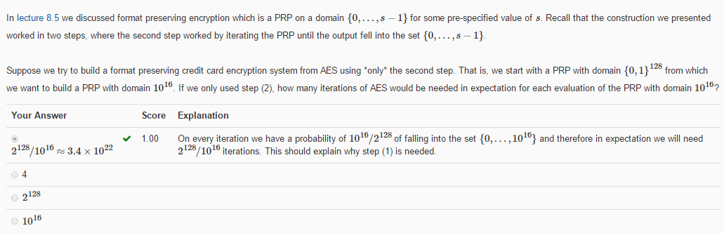
__L1n__w@tch
Question 8
解析：
Each iteration is an independent, identically distributed bernoulli random
variable, so the number of steps in the whole algorithm is a geometric random
variable. The probability of "success" for each trial is p = 10^16/2^128, so
the expected number of trials is 1/p = _2^128/10^16_.

Slide 10
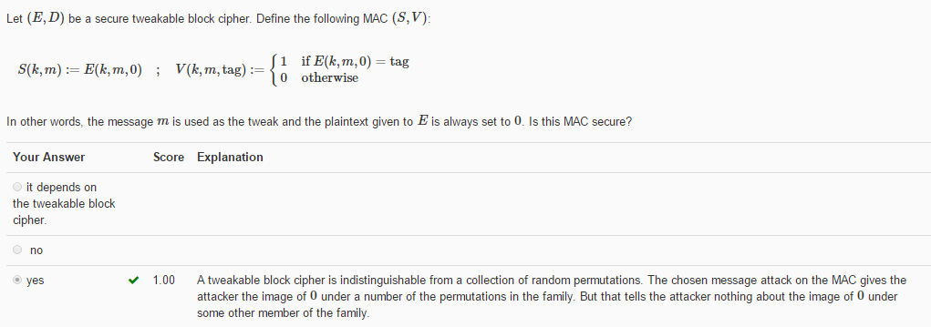
__L1n__w@tch
Question 9
解析：
MAC系统安全要求chosen message attack下安全。

Slide 11
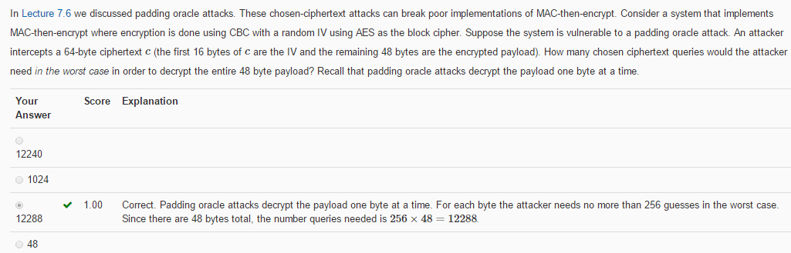
__L1n__w@tch
Question 10
解析：
每个字节都得猜测256次，共48个字节

Slide 12
__L1n__w@tch
In the end
T
H
A
N
K
Y
0
U

